Slide 1
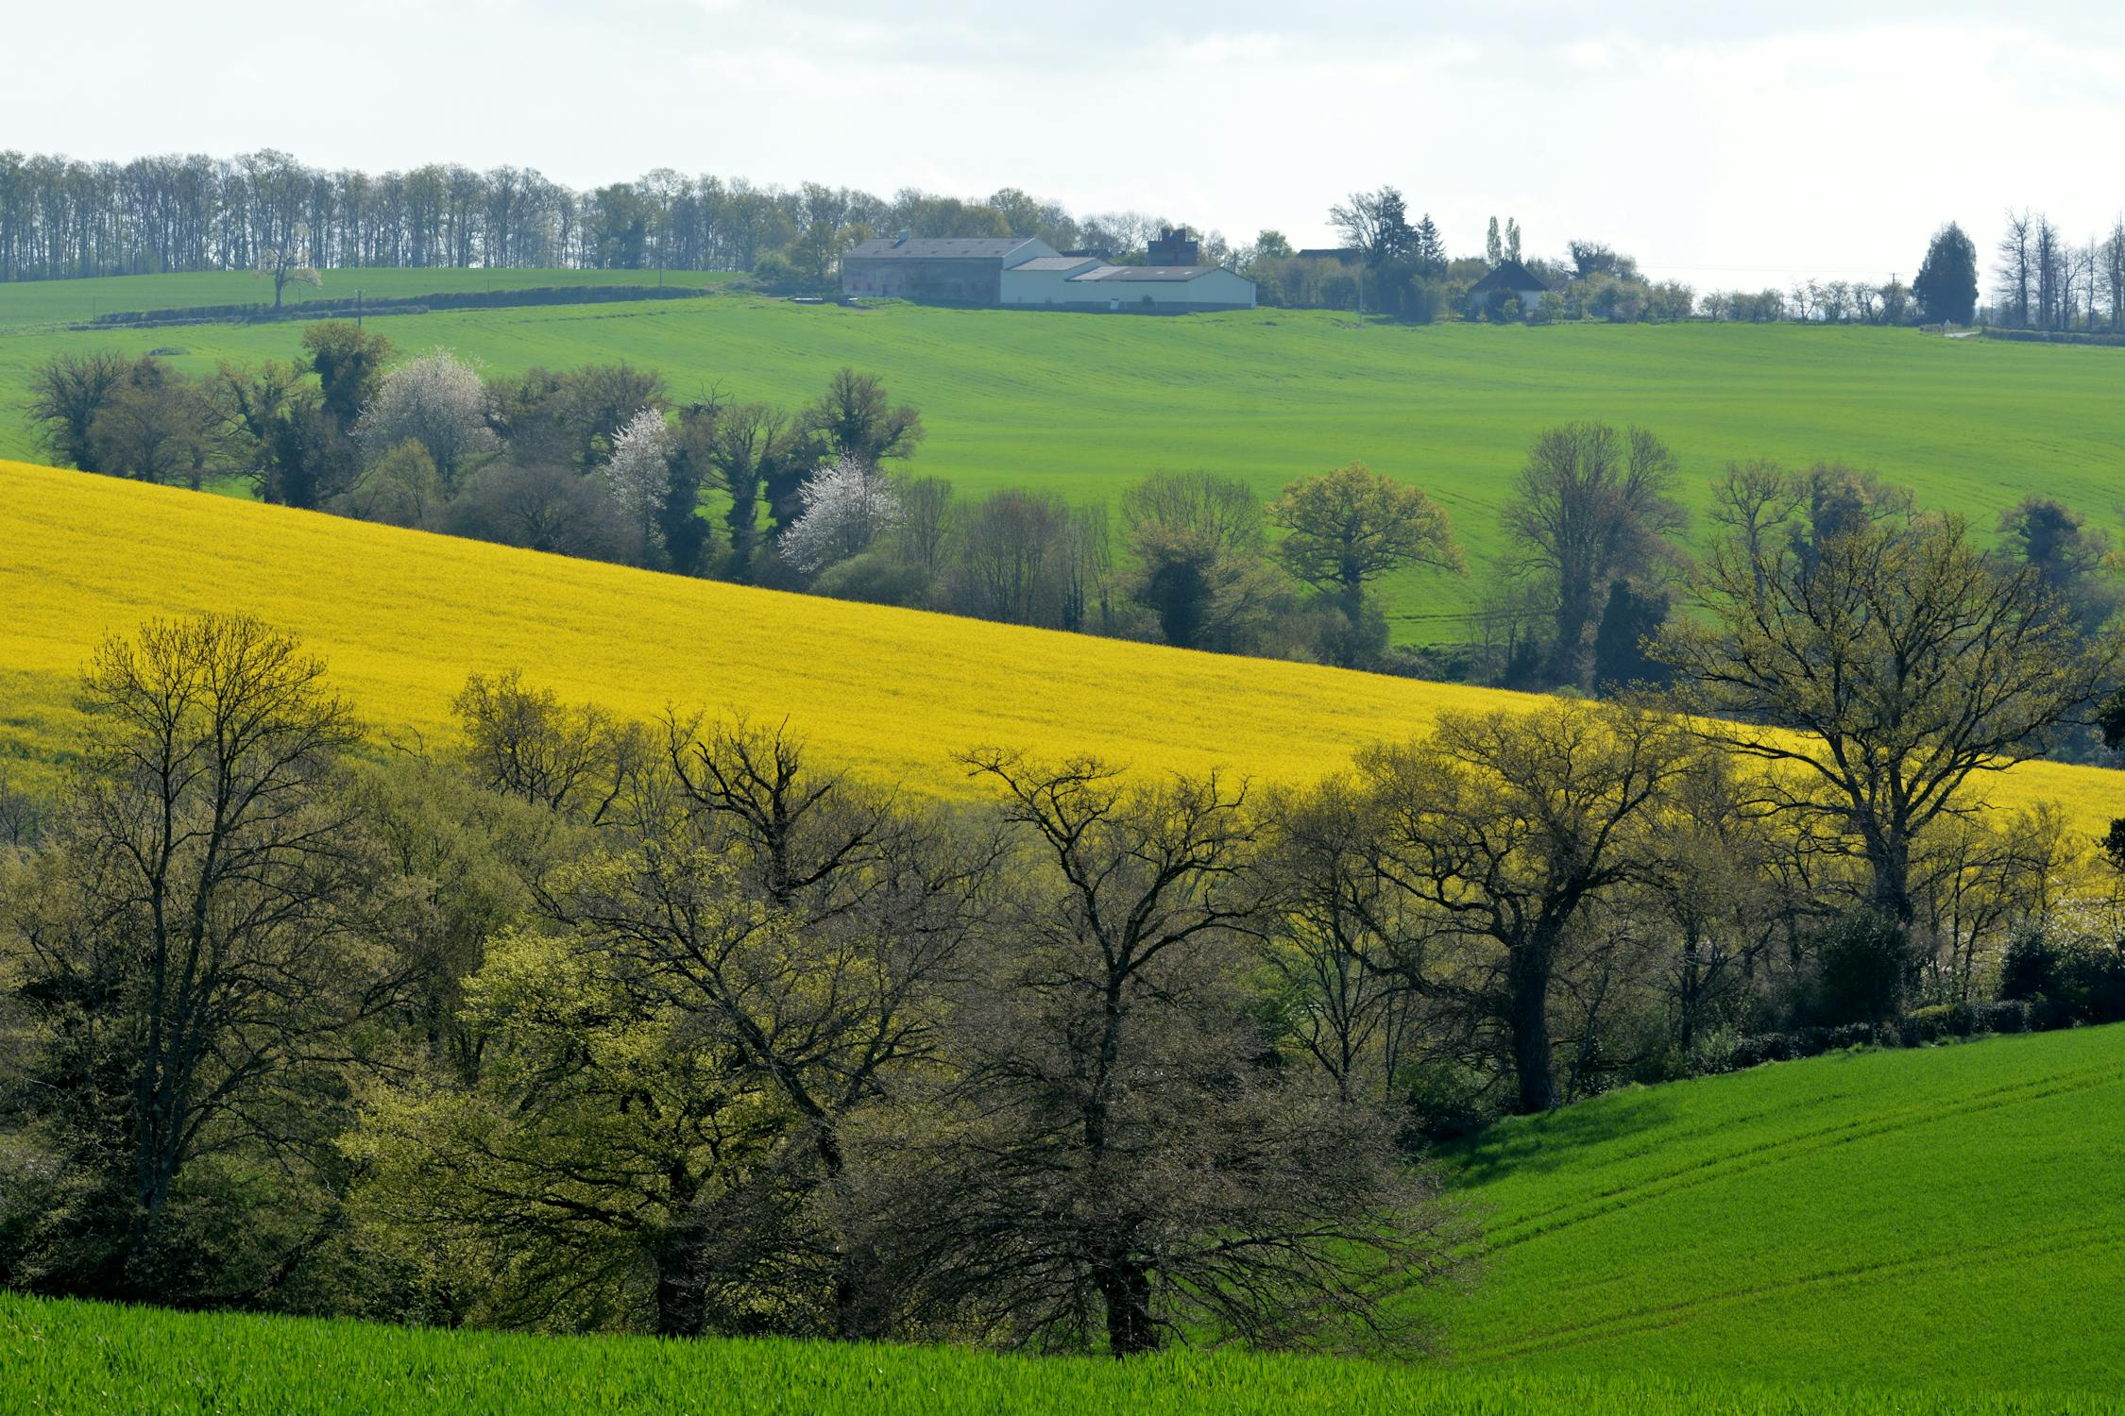
DeepLeaf: Disease Detection Using Neural Networks
Harnessing Image Processing, Neural Network and Machine Learning
Revolutionizing agriculture with AI-powered disease detection for smarter, healthier crops.
GROUP-19

Slide 2
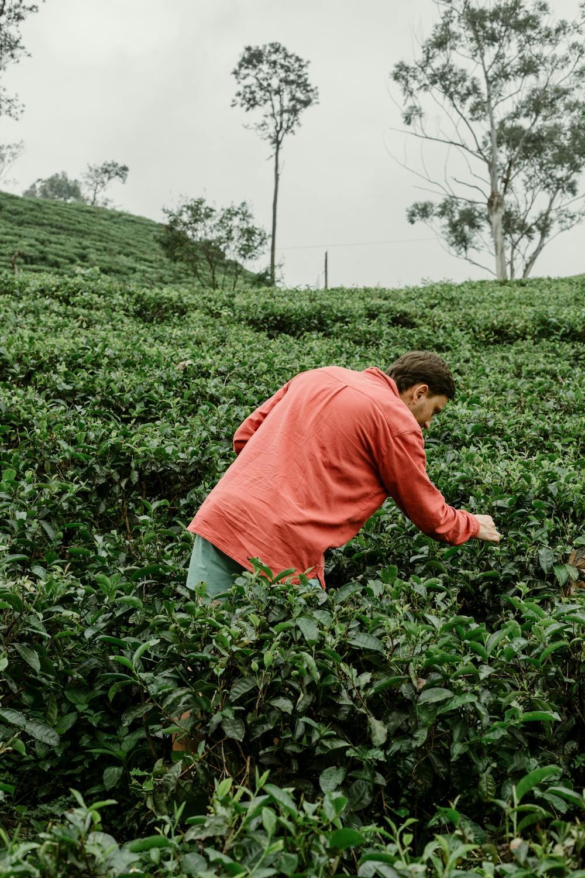



Problem Statement
Manual Detection Inefficiencies
Time-Consuming
Inaccurate
Labor-intensive visual inspection.
Subjective, prone to human error.
Limited Scale
Inefficient Yield
Difficult to monitor large areas.
Delayed detection increases risk of infection

Slide 3
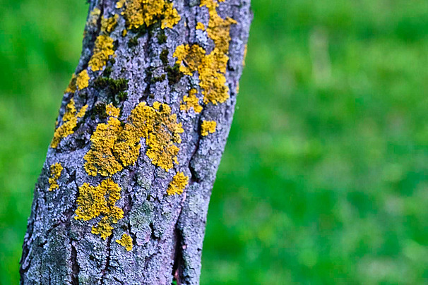
Why Disease Detection Matters
Economic Impact
Reduce yield loss from disease.
Minimize financial strain on farmers.
Food Security
Ensure stable crop production.
Meet global food demand sustainably.

Slide 4
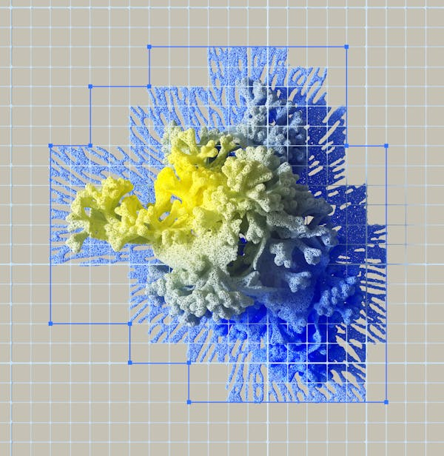
Introduction:
Convolutional Neural Networks (CNNs) are deep learning models used for image tasks like classification and object detection. They use convolution operations to detect patterns in images.
A CNN has three main layers:
Convolutional Layer: Extracts features using filters.
Pooling Layer: Reduces the size of feature maps.
Fully-Connected Layer: Outputs the final prediction.
Early layers detect simple features (like edges), while deeper layers recognize complex patterns. CNNs learn by adjusting filter weights through backpropagation and gradient descent.

Slide 5
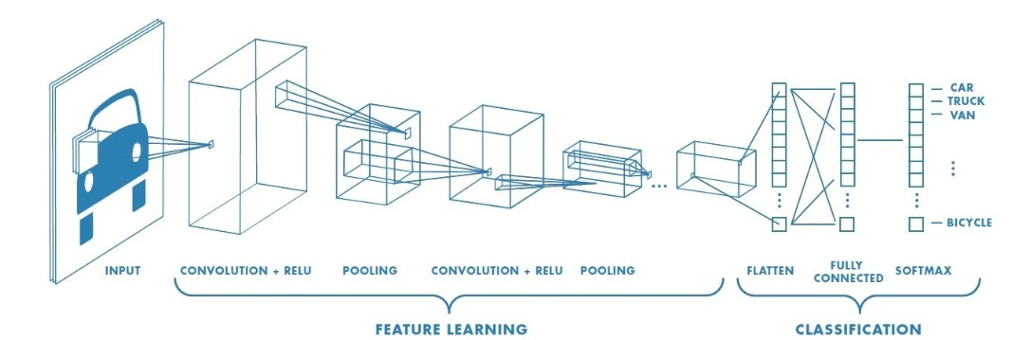



Architecture: CNN in Action

Slide 6
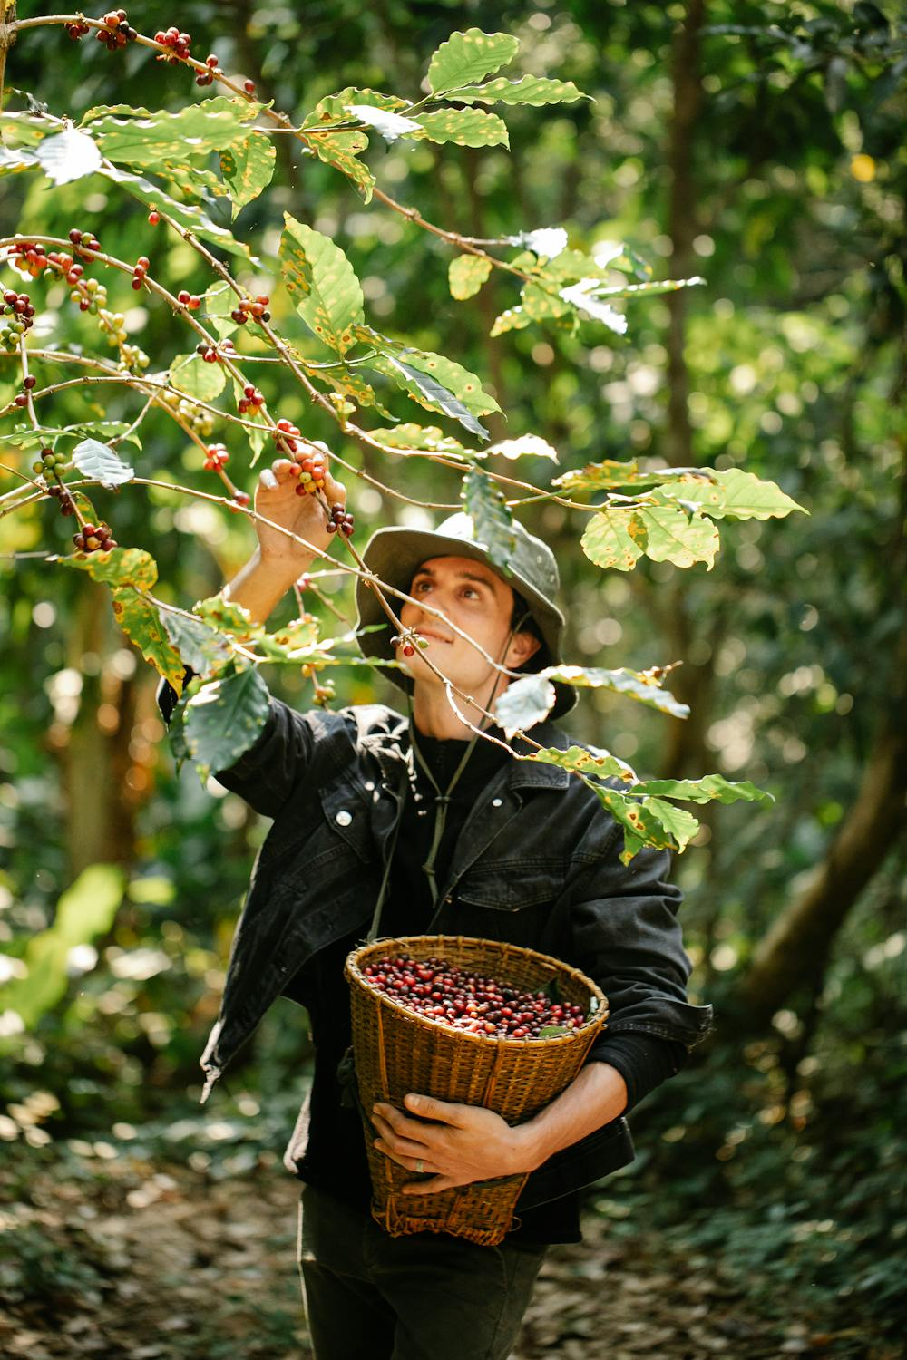




Our Solution: Image
Processing Using Neural Networks
Image Capture
Processing
Diagnosis
Analysis

Slide 7
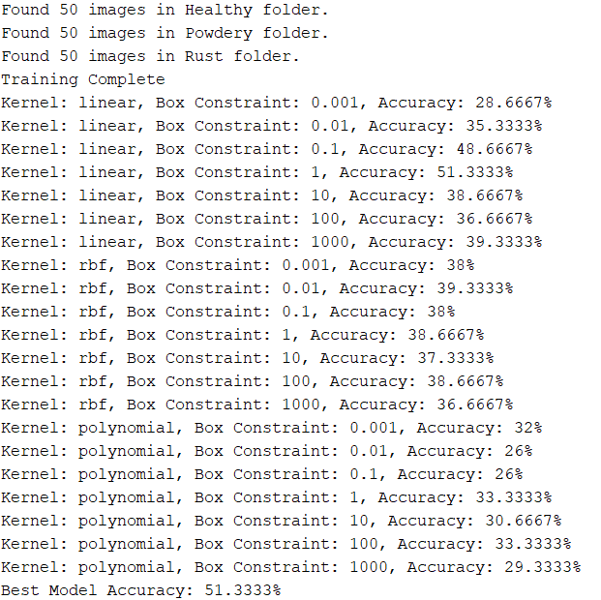
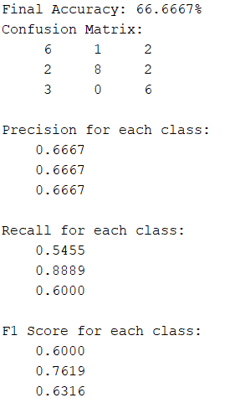
Performance Metrics of SVC Algorithm Using MATLAB

Slide 8
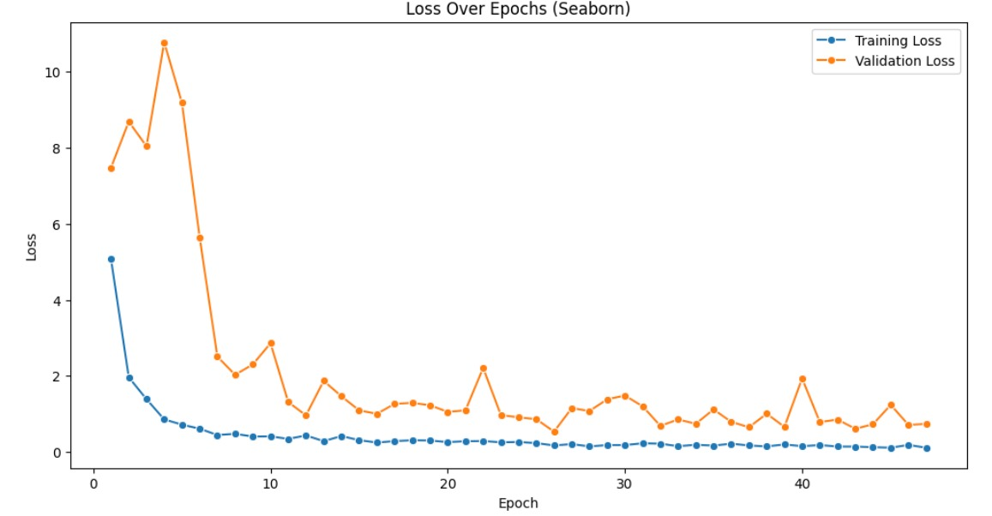
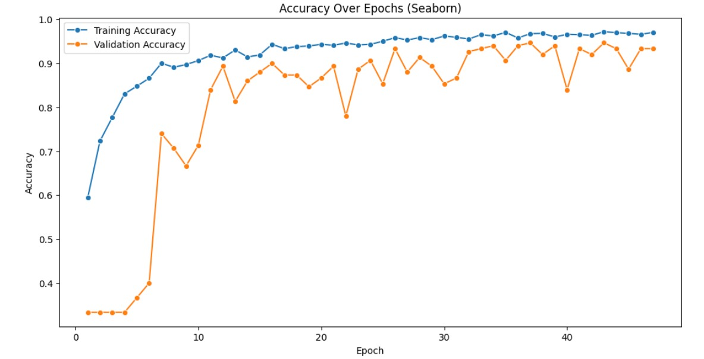
Performance Metrics of CNN Using Python

Slide 9
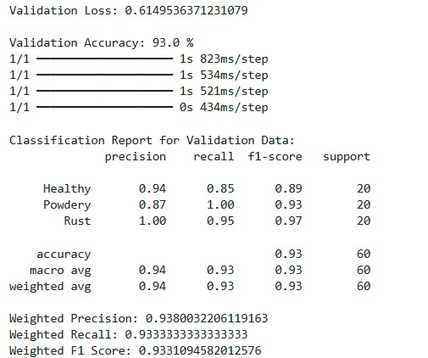
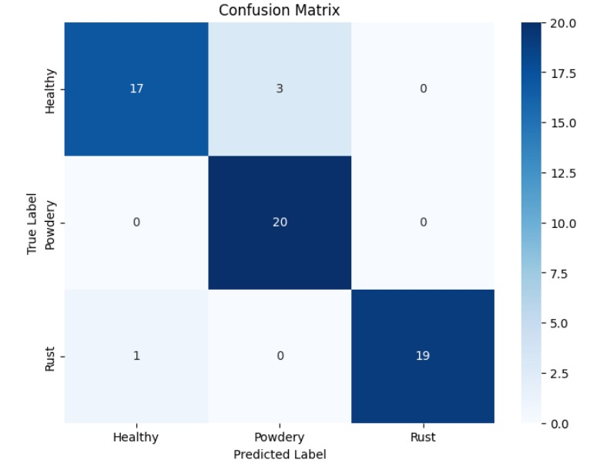
Performance Metrics of
CNN Using Python

Slide 10
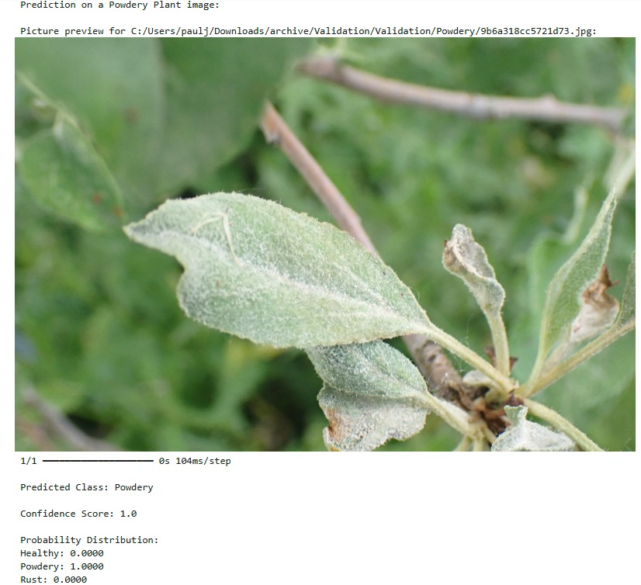
Testing Analysis

Slide 11
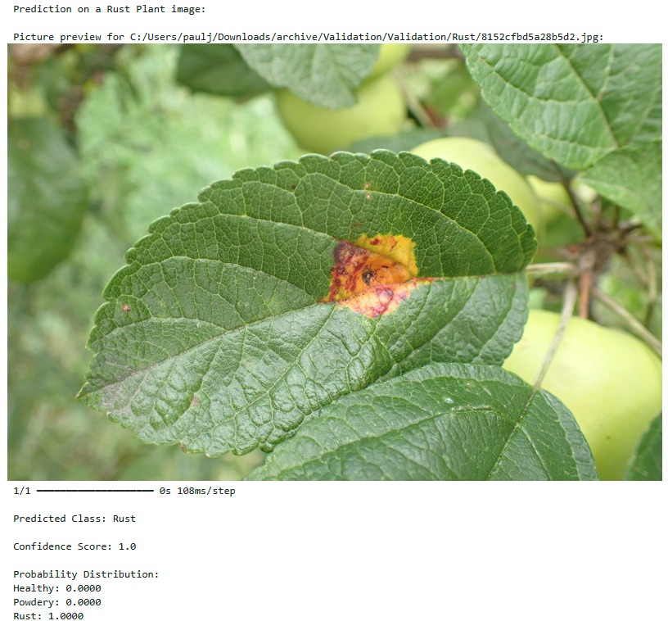
Testing Analysis

Slide 12
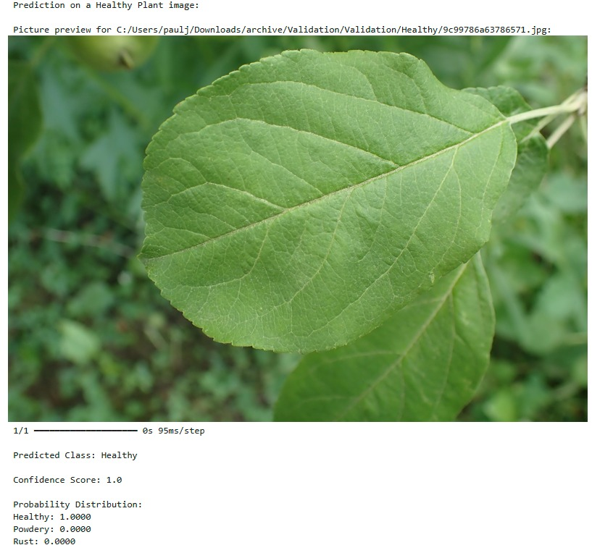
Testing Analysis

Slide 13
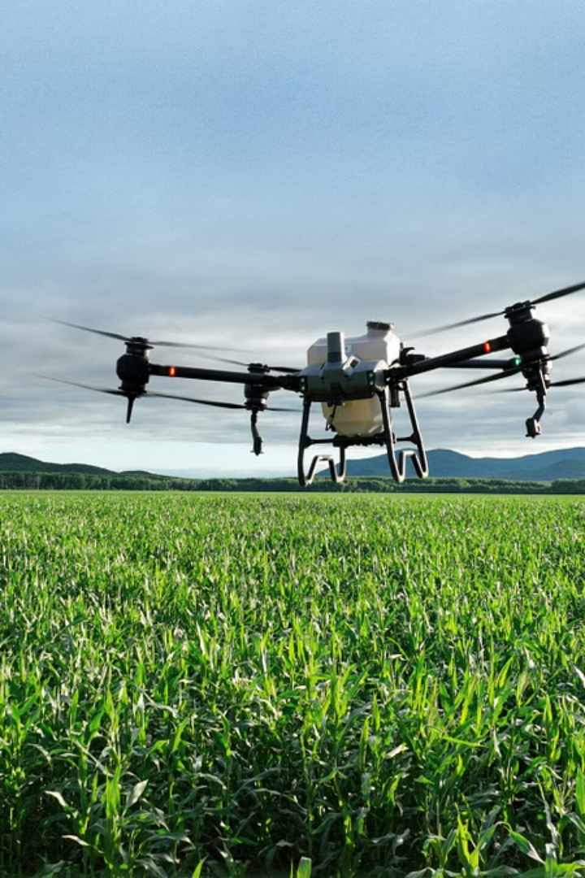
Future Scope
Social media: Detects faces for organizing photo albums.
Healthcare: Identifies diseases from medical images.
Agriculture: Monitors crops using computer vision.
Security: Detects suspicious activity in real time.
Finance: Find real-time patterns in stock prices.
Automotive: Computer vision powering self-driving cars.

Slide 14
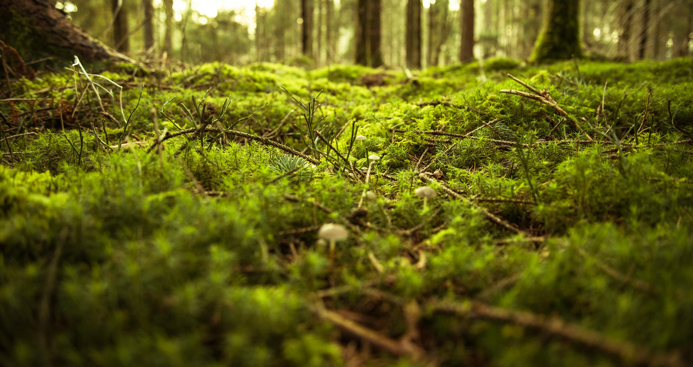
DeepLeaf: Cultivating a Healthier Tomorrow
Join us in revolutionizing agriculture with AI-powered solutions for a sustainable future.

Slide 15


